Slide 1


TITLE: Netflix Content Analytics & Strategic Insights Dashboard
TEAM CODE:

Slide 2
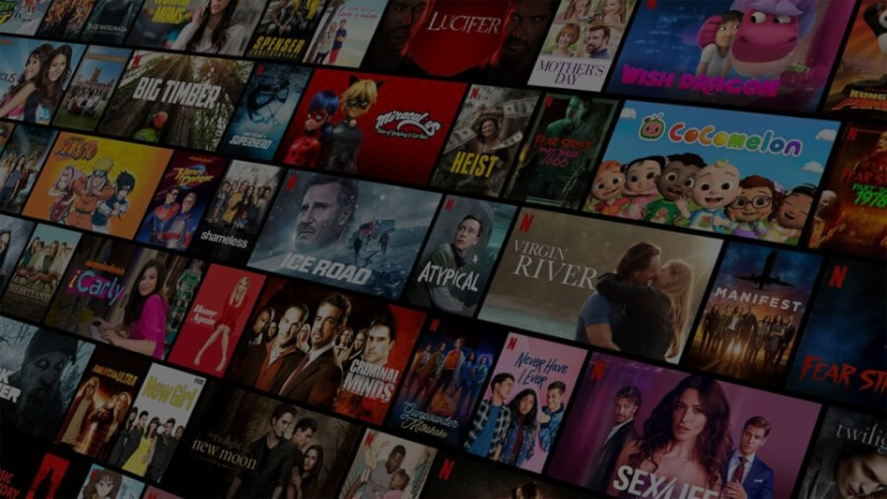




TITLE:
Netflix Content Analytics & Strategic Insights Dashboard
Play
Info
STARRING:
TEAM CODE

Slide 3








Key
Findings
Content
Landscape
Temporal Trends
Geographic Strategy
Genre Intelligence
Content Creators
Strategic Recommendations
Data Methodology

Slide 4
KEY FINDINGS

Slide 5
KEY FINDINGS

Slide 6
KEY FINDINGS

Slide 7
CONTENT LANDSCAPE

Slide 8
CONTENT LANDSCAPE

Slide 9
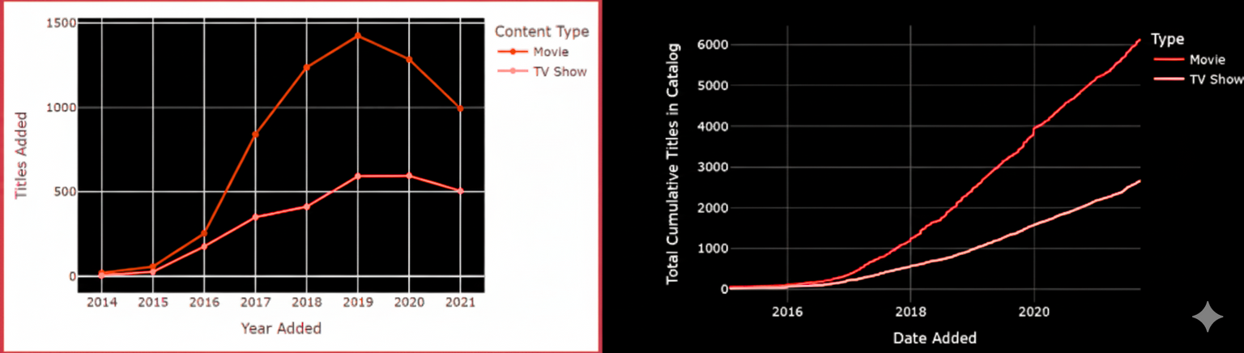
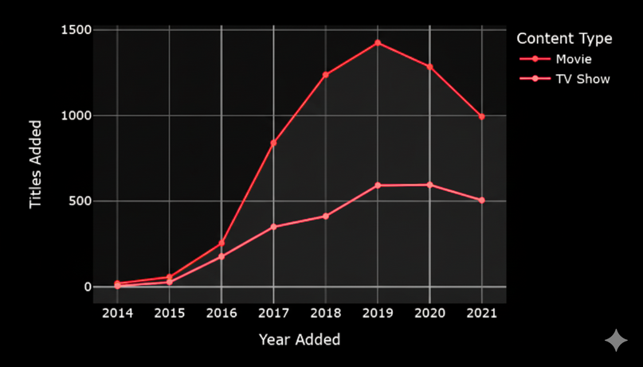
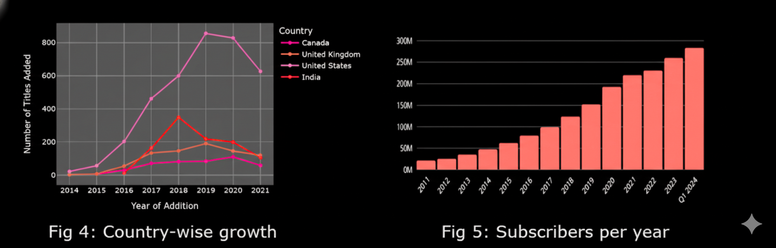
TEMPORAL TRENDS
Type
Movie
TV Show
Content type
Movie
TV Show
Overall Content Acquisition Peaked and Declined: The total annual addition of new titles peaked at approximately 2,000 in 2019 before experiencing a deliberate and notable slowdown, driven almost entirely by a sharp reduction in licensed movies.
Strategic Shift from Quantity to Quality: Netflix's strategy changed from focusing on building a "broad" library for rapid subscriber acquisition (Pre-2019) to focusing on retention and quality Originals (Post-2019) as the market matured.
Movies Drove Early Growth: The aggressive growth in total titles from 2016 to 2019 was primarily a function of a surge in new movie acquisitions, which consistently outnumbered TV shows.
TV Shows Key to Retention: The post-2019 strategy elevated the importance of TV shows as the "single most powerful tool for subscriber retention" due to their high Return on Investment (ROI) measured by engagement hours and their ability to reduce churn.
Increased Investment in Originals: Following the shift to retention, the number of Originals increased substantially after 2019, despite these titles being significantly more expensive than average licensed content.
Slower Growth is Justified: The natural slowdown in platform growth post-2019 is considered a justified strategy because sustaining the exponential growth seen in the early years was unrealistic with a massive and maturing existing subscriber base.
Subscribers per year
Country Wise Growth

Slide 10
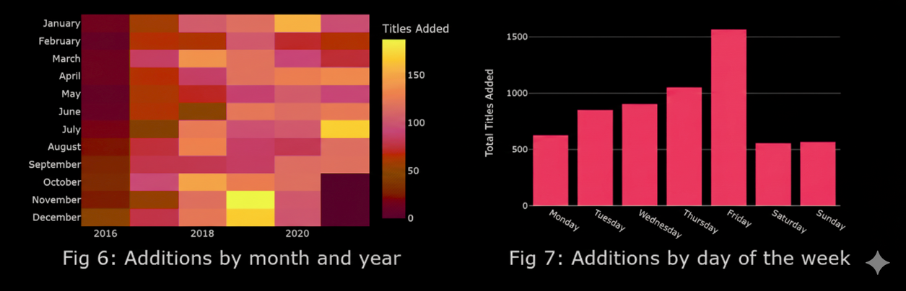
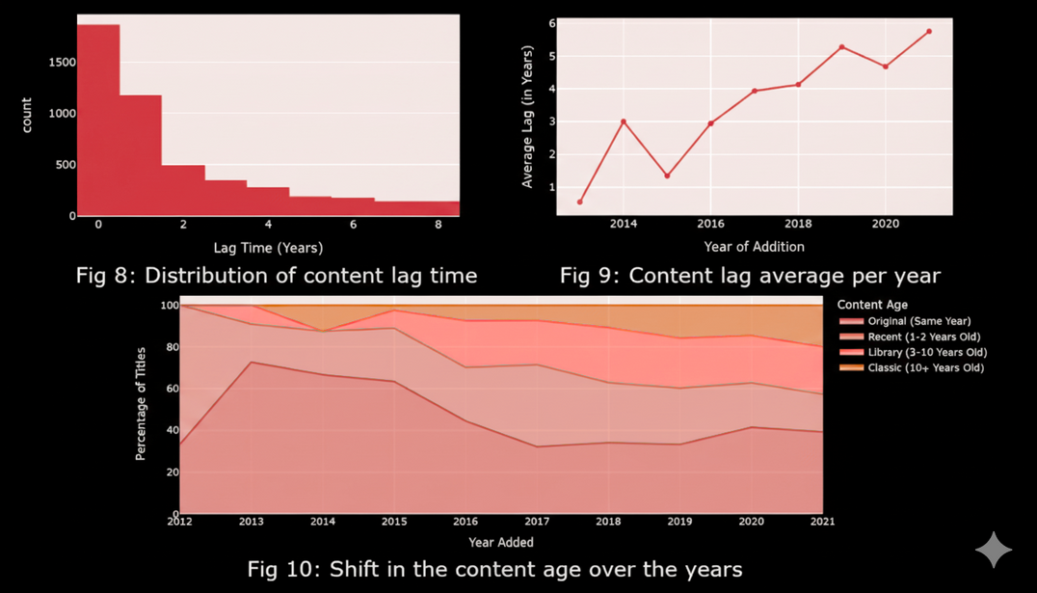
SEASONAL AND CYCLIC PATTERNS
Weekend Consumption Focus (Micro): The daily schedule maximizes viewing by creating a Friday content spike to establish a "New Release Day" habit, followed by an intentional weekend "dead zone" to ensure subscribers consume the new titles.
Seasonal Maximization (Macro): The long-term strategy aligns content drops with audience behavior, making Q4 (October-December) the peak period for new additions to capture holiday viewership, while scheduling strategic slowdowns in Q1 for efficiency.
TIME LAG ANALYSIS
Content Age Increased to Fund the Acquisition Boom (2016-2019): To rapidly build a massive library for subscriber acquisition, Netflix made a deliberate cost-control pivot by shifting away from "fresh" content. The platform strategically acquired cheaper, older "Library" titles, which caused the average lag time (age of new additions) to sharply climb from $\sim$2.9 to $\sim$5.2 years. This sacrifice of freshness directly funded the massive volume of new additions.
Market Forces Mandated Older Content, Driving Originals for Retention (Post-2019): After 2019, the average age of newly licensed content continued to increase, peaking at nearly six years. This was largely forced by market competition, as rivals pulled their recent content, restricting Netflix to even older back-catalogs. This licensing difficulty reinforced the strategic shift toward prioritizing expensive Originals, which now serve as the exclusive, high-value magnet for subscriber retention.

Slide 11
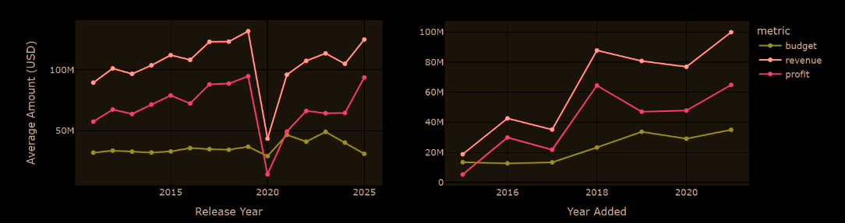

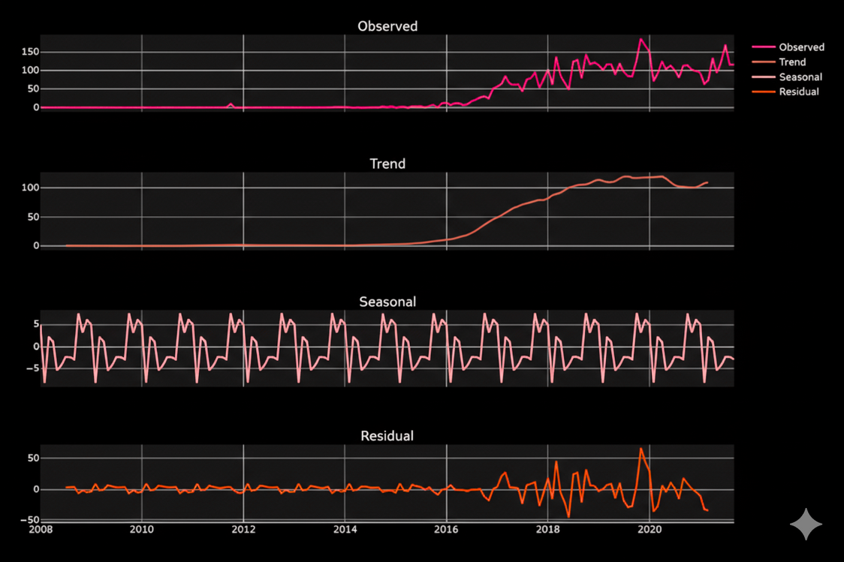
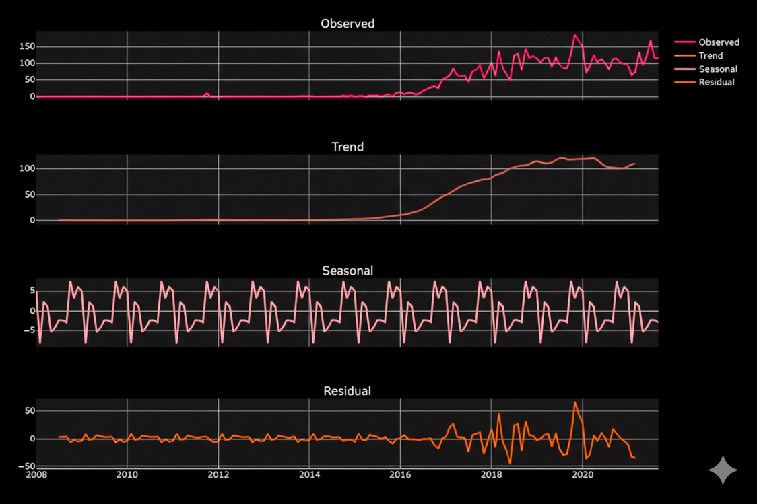



STRATEGIC INFLECTION POINTS
The "Pivot to Retention”"
(2019)
Defend mass-market scale against emerging competition (e.g., Disney+, HBO Max) once subscriber growth became unsustainable.
The "Pivot to Volume"
(2015-2016)
Win the global subscriber land grab by prioritizing scale over prestige (the "Get Big Fast" strategy).
The "Great Disruption"
(2020-2021)
Overcome the COVID-19 pandemic's disruption and the licensed content squeeze by competitors.

Slide 12
GEOGRAPHIC STRATEGY

Slide 13
GEOGRAPHIC STRATEGY

Slide 14
GENRE INTELLIGENCE

Slide 15
GENRE INTELLIGENCE

Slide 16
CONTENT CREATORS

Slide 17
CONTENT CREATORS

Slide 18
STRATEGIC RECOMMENDATIONS

Slide 19
STRATEGIC RECOMMENDATIONS

Slide 20
STRATEGIC RECOMMENDATIONS

Slide 21
DATA METHODOLOGY

